Slide 1


C++ and C# Programming
By: Gus Saalfeld

Slide 2
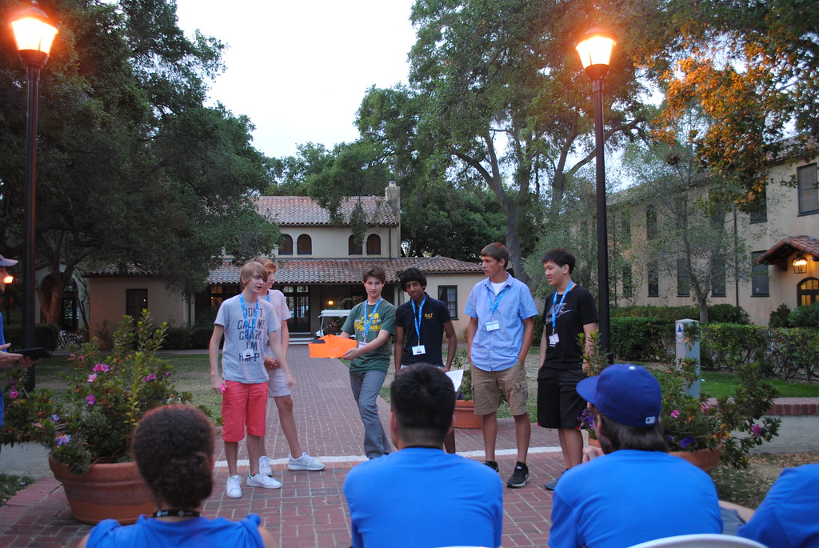
Stanford University
Replace this image with your own. Then delete this text.
C++ Game Programming
(June 17nd – June 31th)

Slide 3
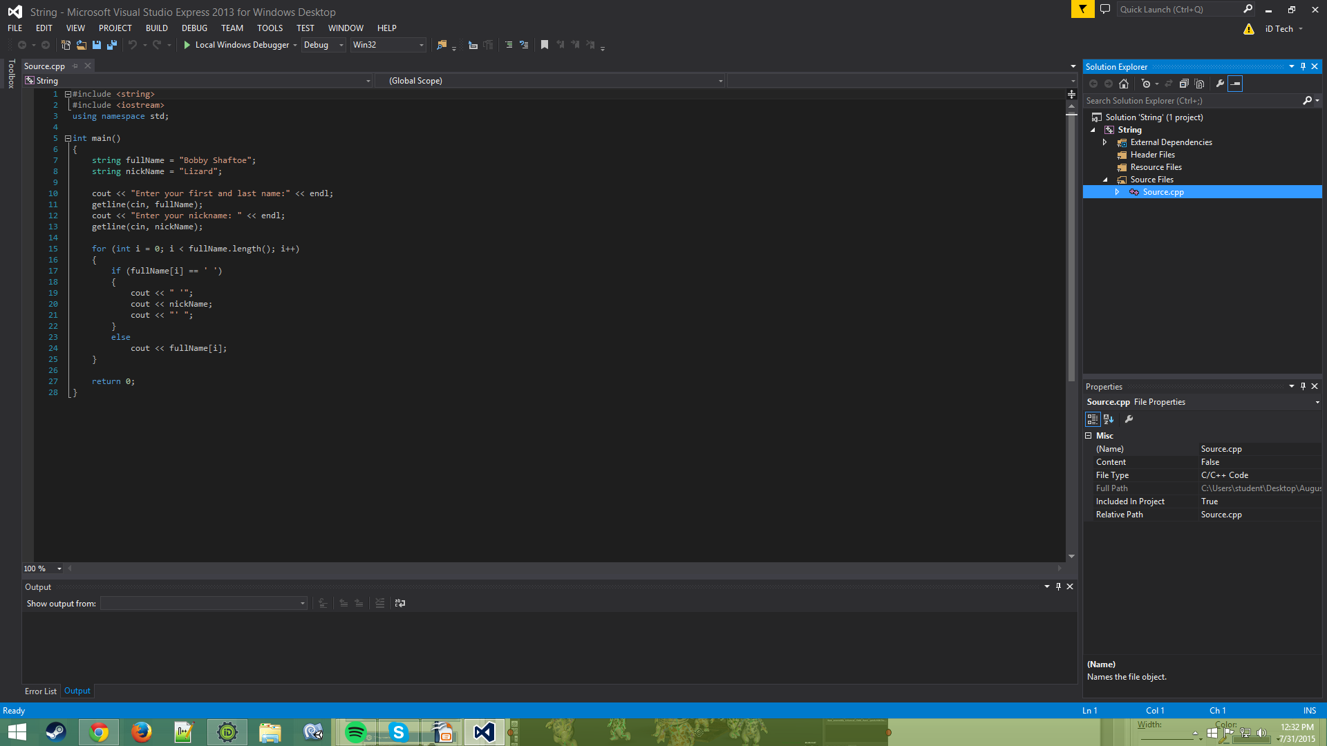
Week 1 – Learning C++
Basic C++:
The Basics
Classes
Frames
SFML
Replace this image with your own screenshot. Then delete this text.

Slide 4
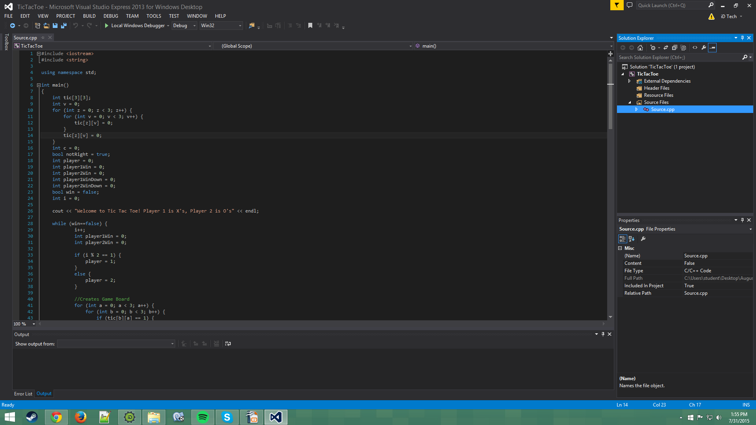
Week 1 – Project
TicTacToe:
Objective was to make tictactoe in the console
Had to have the board printed, player input and win conditions
Learned how to bug fix my code and improved on my problem solving
Replace this image with your own screenshot. Then delete this text.

Slide 5
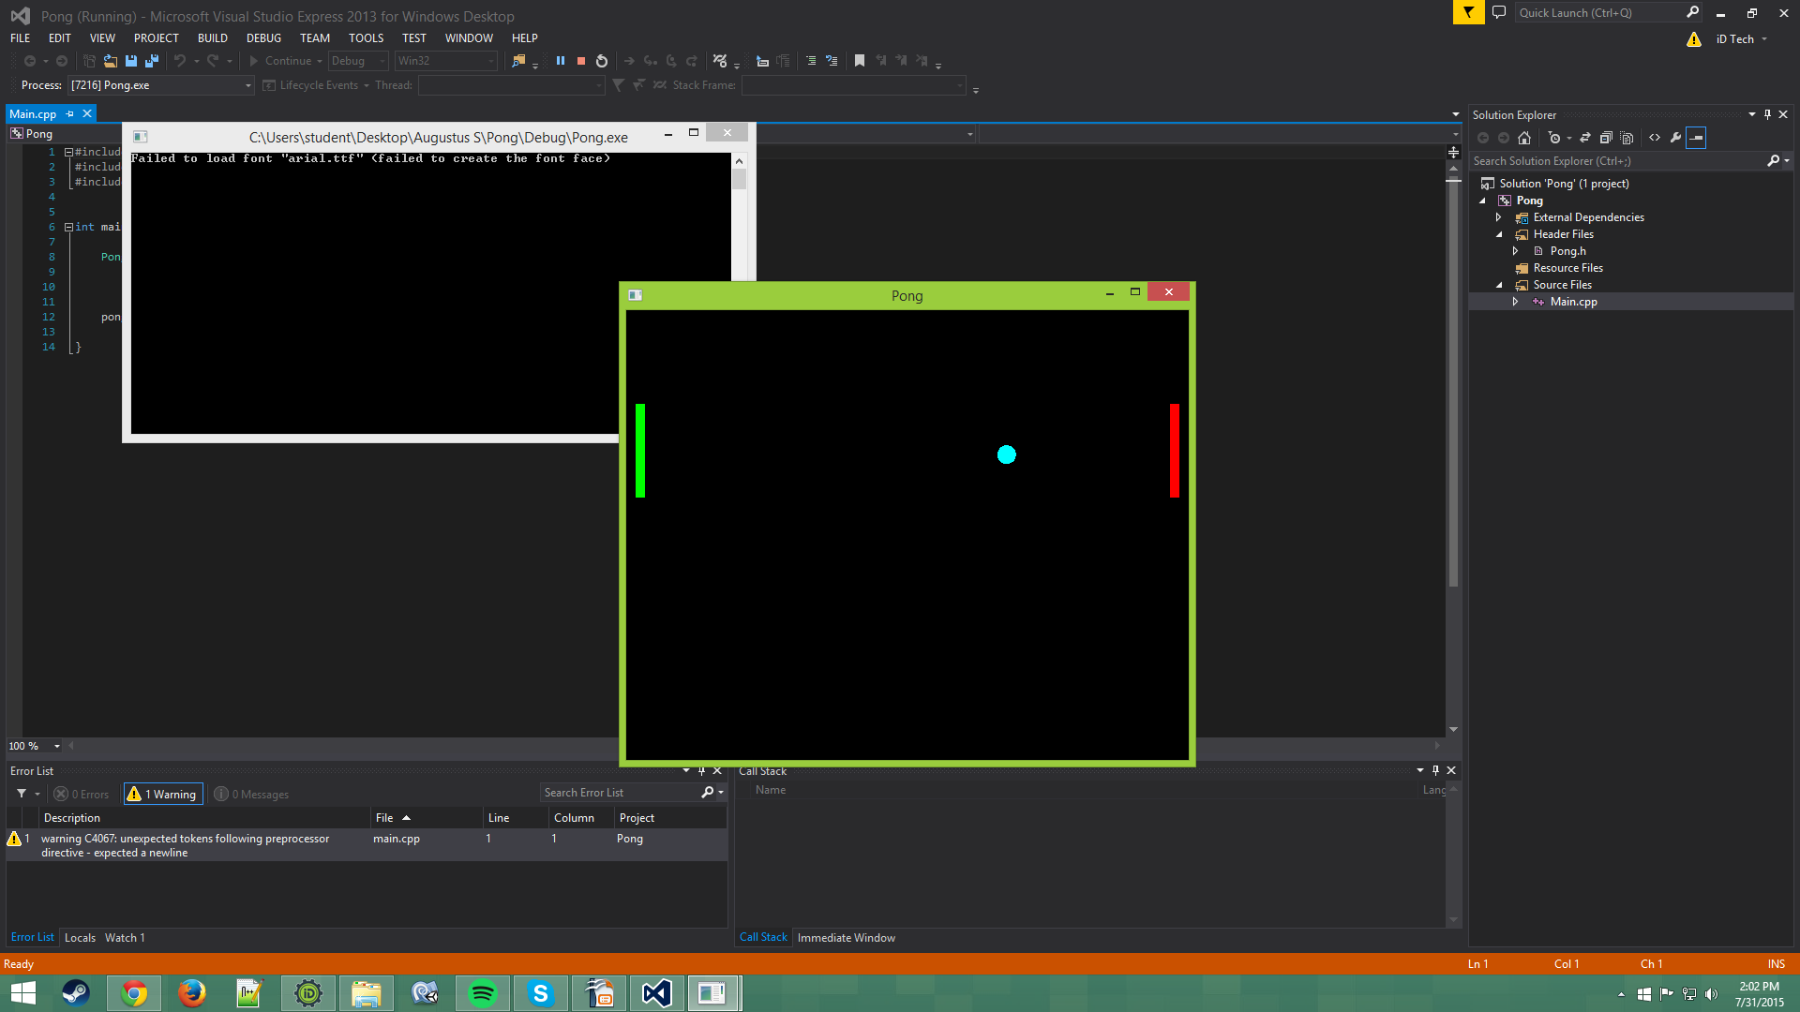
Week 1 – Project
Pong:
Learned how to set up the screen
Learned how to do physics in sfml
Made a fun pong game
Replace this image with your own screenshot. Then delete this text.

Slide 6
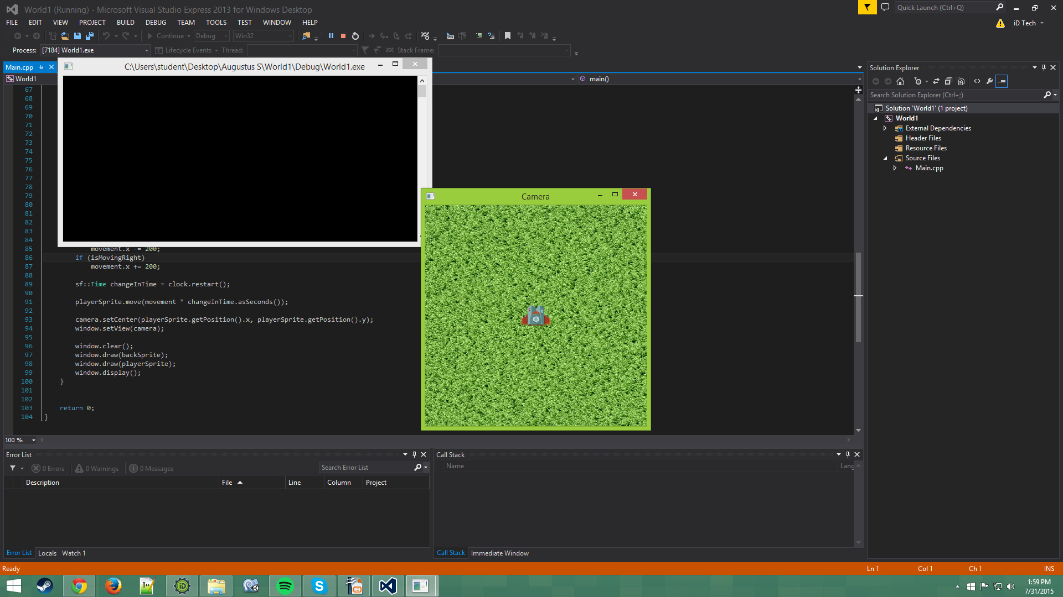
Week 1 – Project
Coding With SFML:
Learned how to use sfml to make game screens and game environments
Made a player that moves using keyboard input
Made the camera follow the player
Created the window for the screen and loaded the sprites
Replace this image with your own screenshot. Then delete this text.

Slide 7
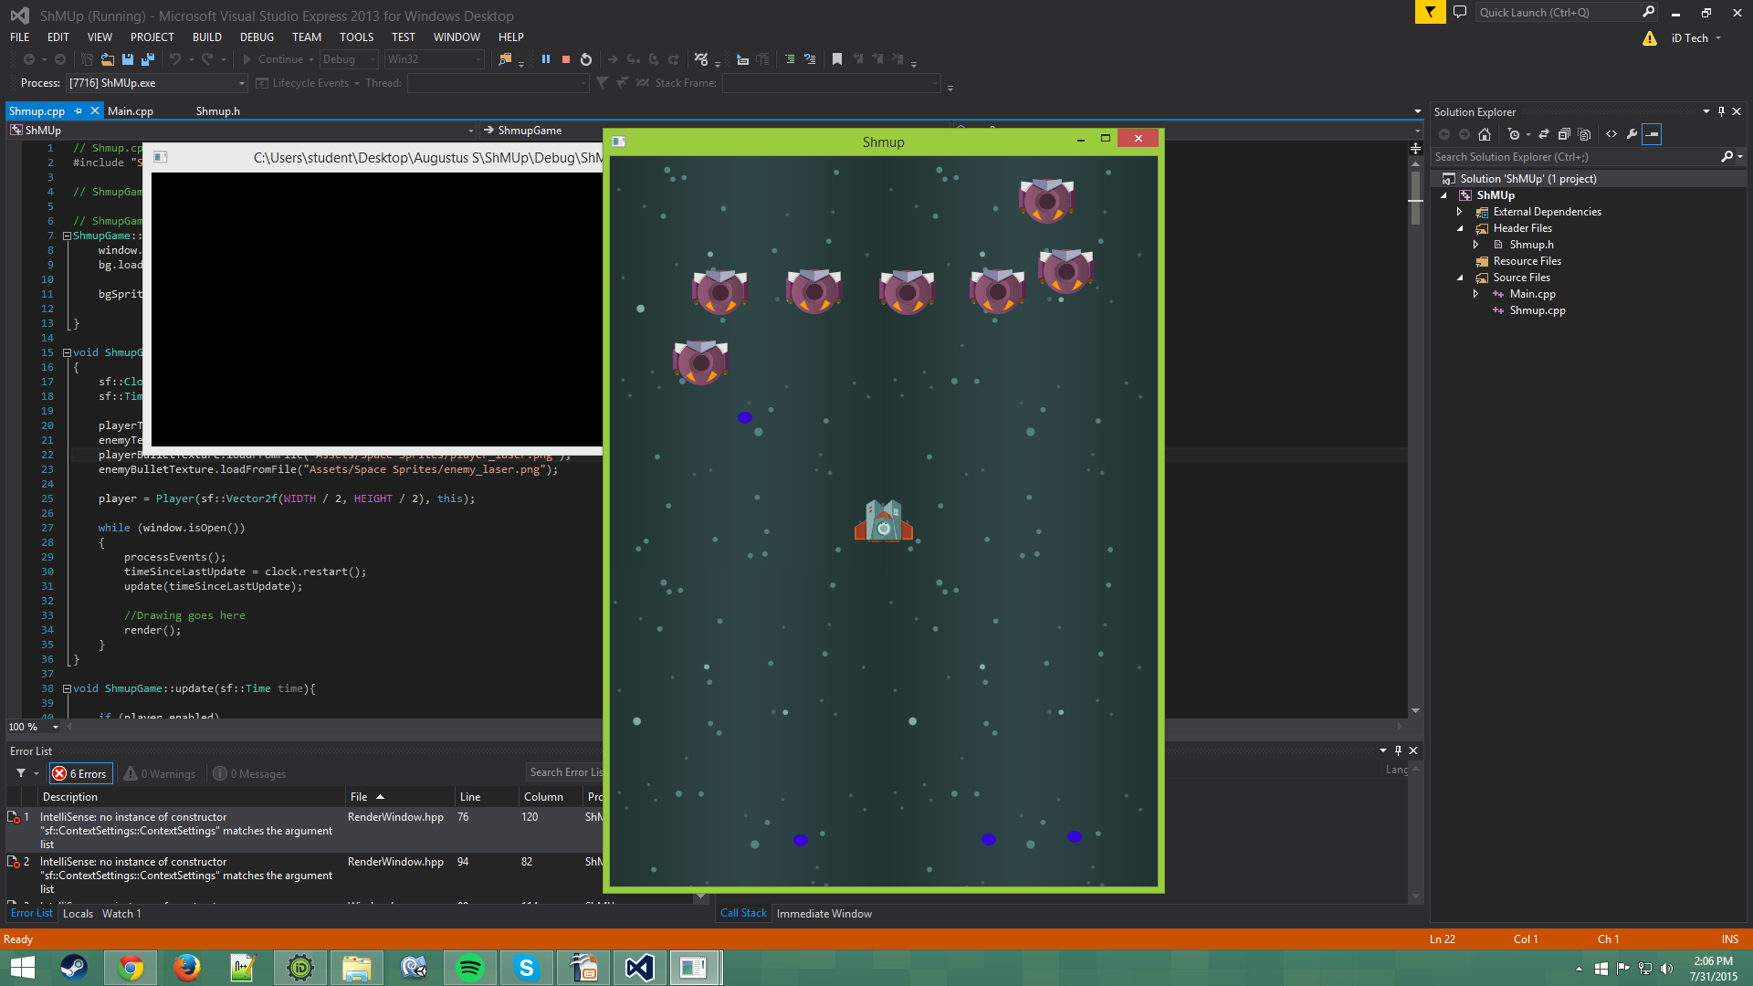
Week 1 – Milestone
Project Title:
Throughout the first week I learned all the basics of C++ and more
I managed to accomplish a lot and ended up making a shoot em up at the end of the week.
Replace this image with your own screenshot. Then delete this text.

Slide 8
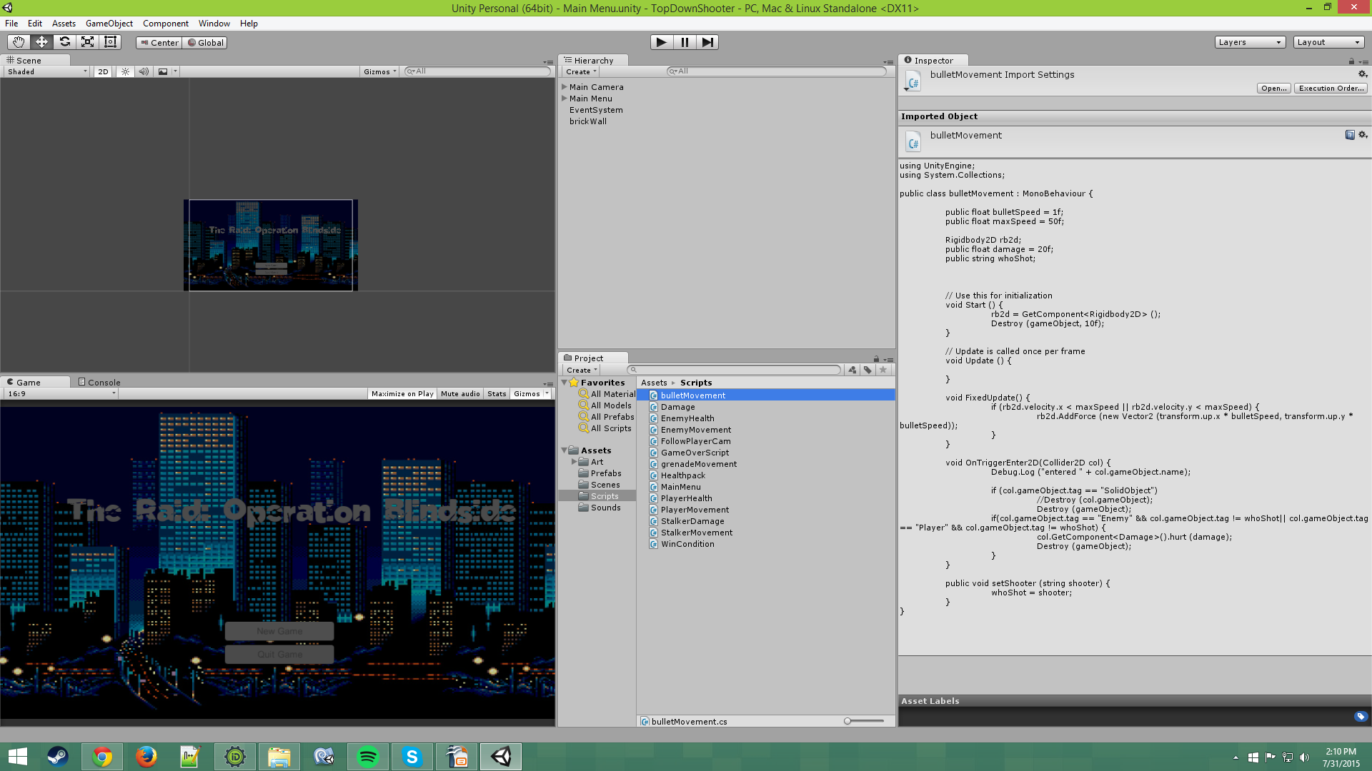
Week 2 – Project
Game in Unity:
I started learning unity, which is a game engine
I began setting up all the basics for making a game and finished the menu screen
Replace this image with your own screenshot. Then delete this text.

Slide 9
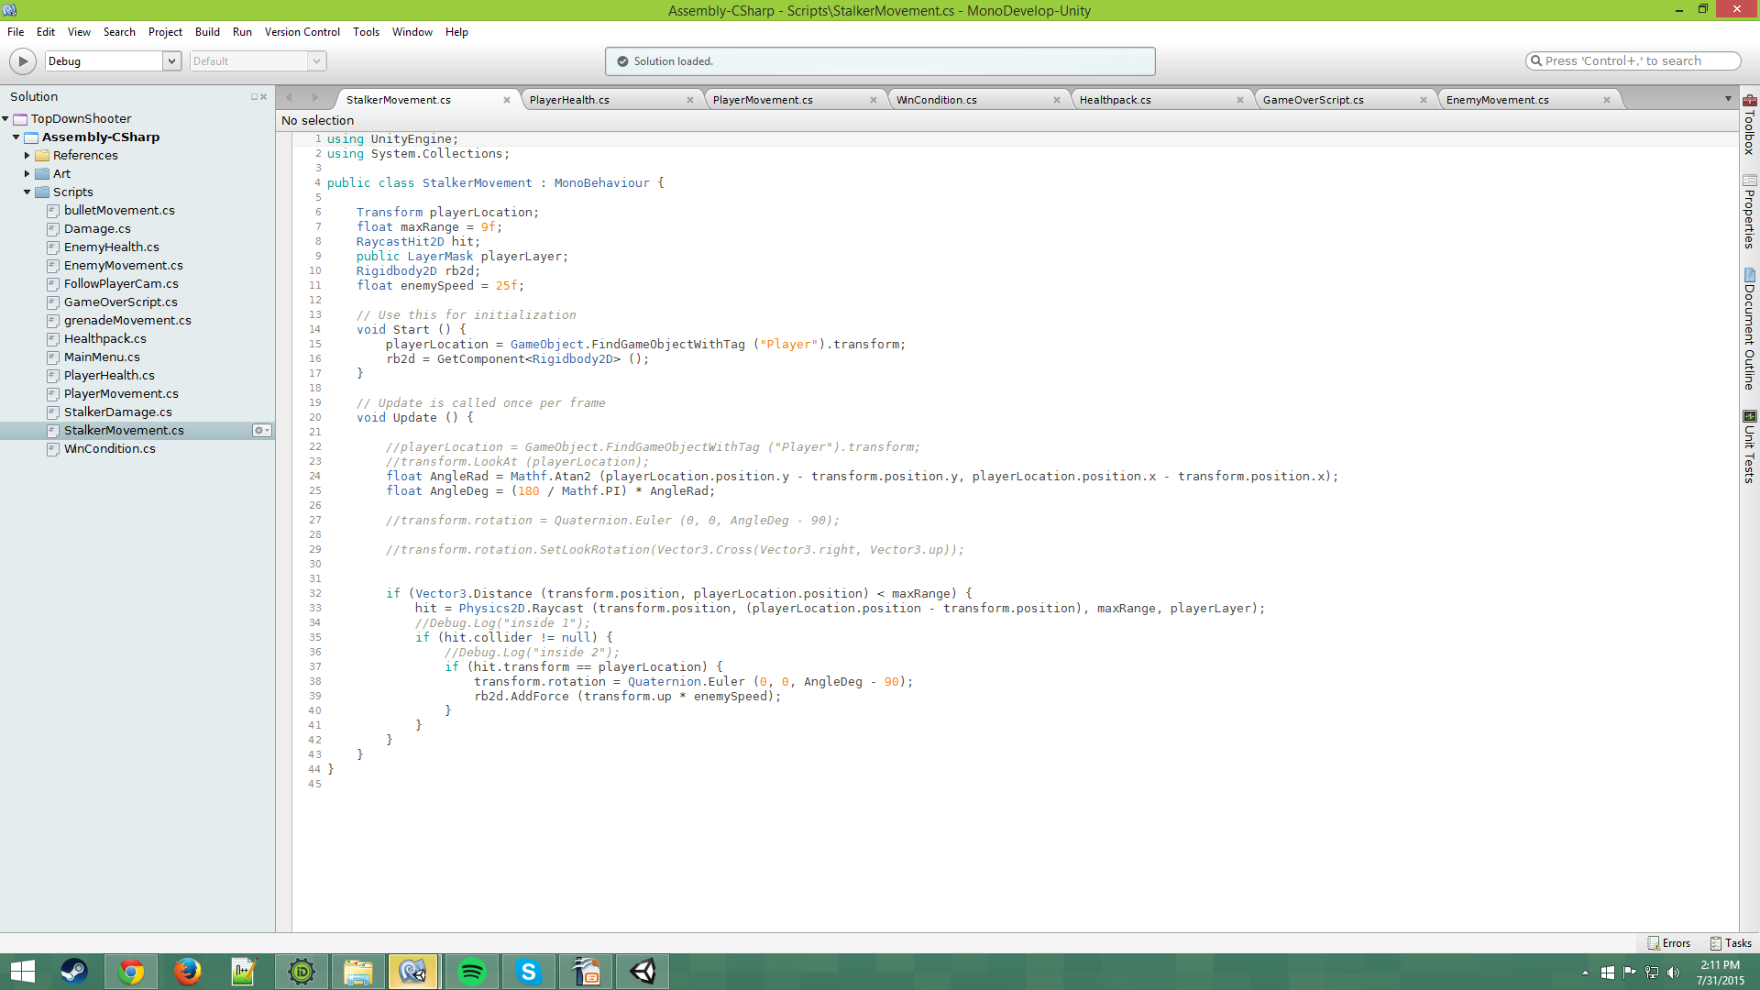
Week 2 – Project
Game in Unity:
I began coding in everything the game has: collision, firing enemies, player movement and player looking at mouse
I added these scripts to objects and set up all the basics in making a game
Replace this image with your own screenshot. Then delete this text.

Slide 10
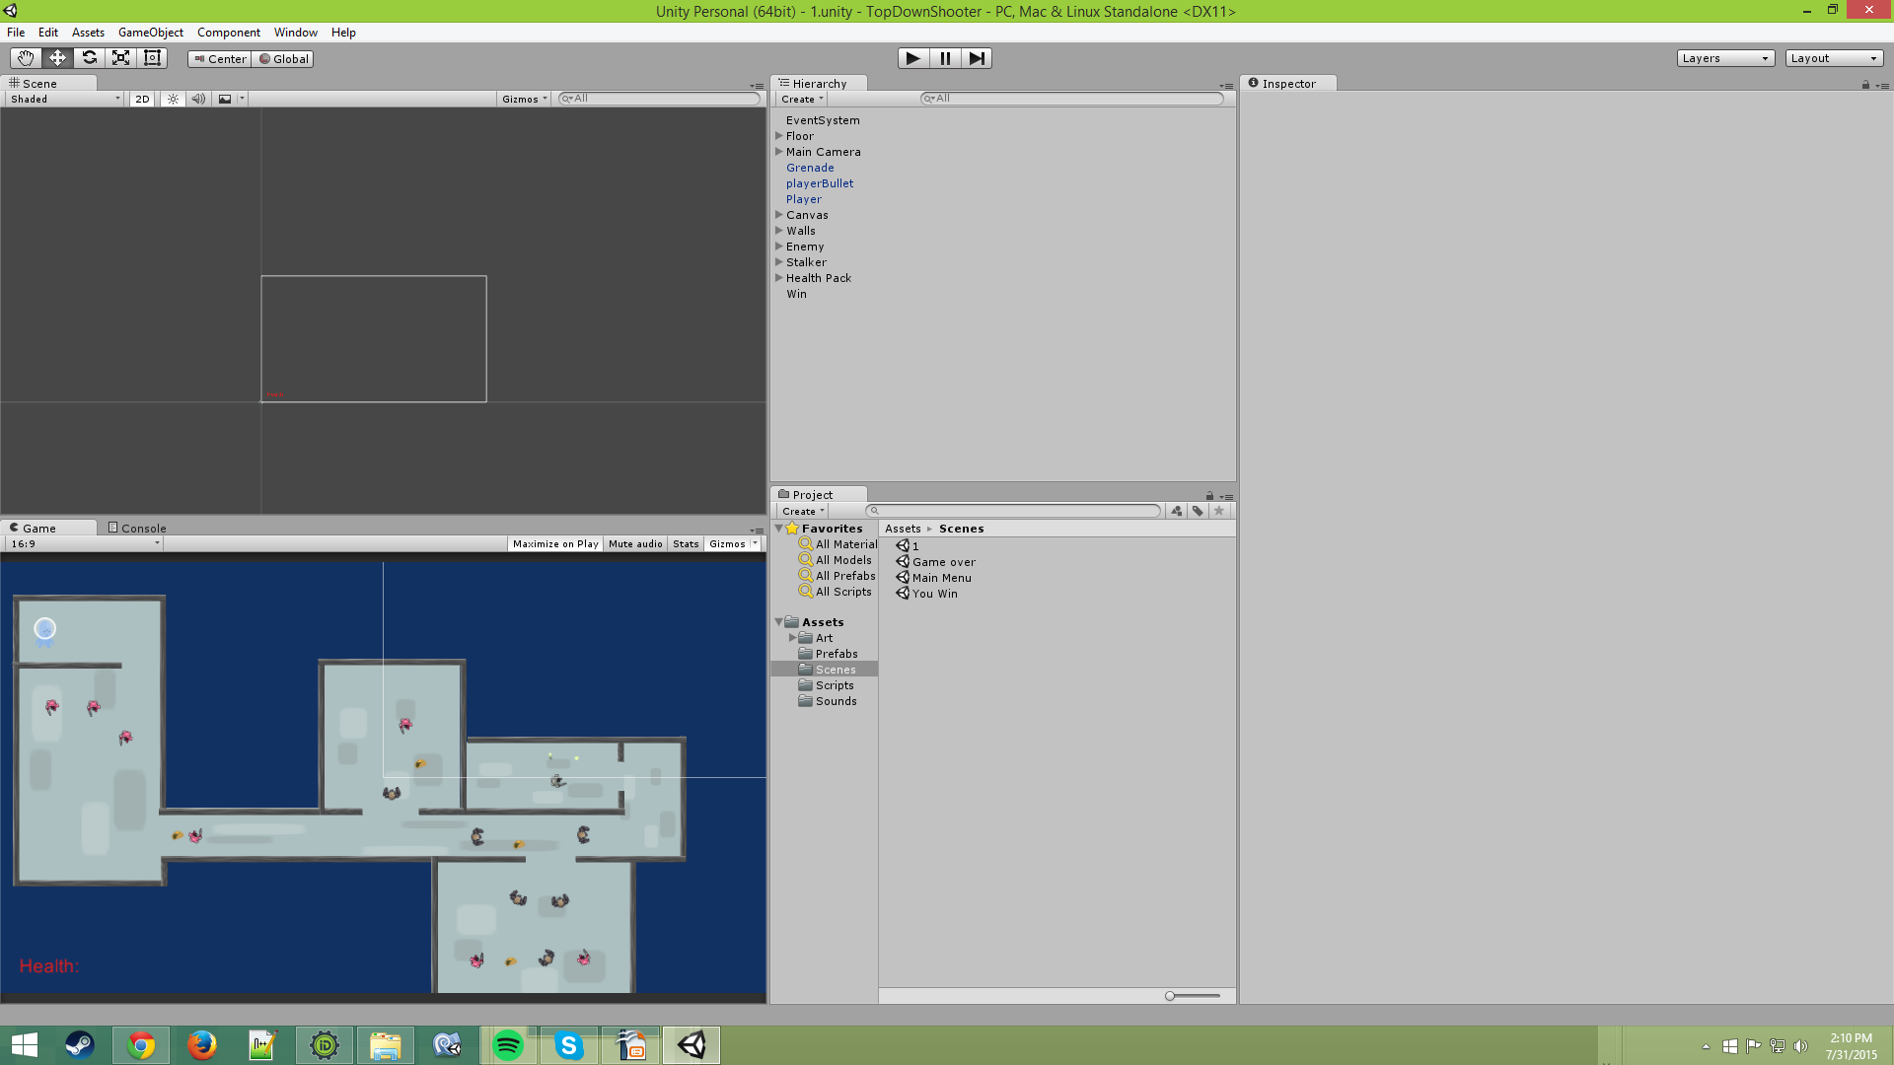
Week 2 – Milestone
Game in Unity:
I finished all the basics and made a little test level
After spending a lot of time, I learned a lot of the basics of Unity and was able to make my own level
Using this code I made and my knowledge, I would be able to make a full game
Replace this image with your own screenshot. Then delete this text.

Slide 11
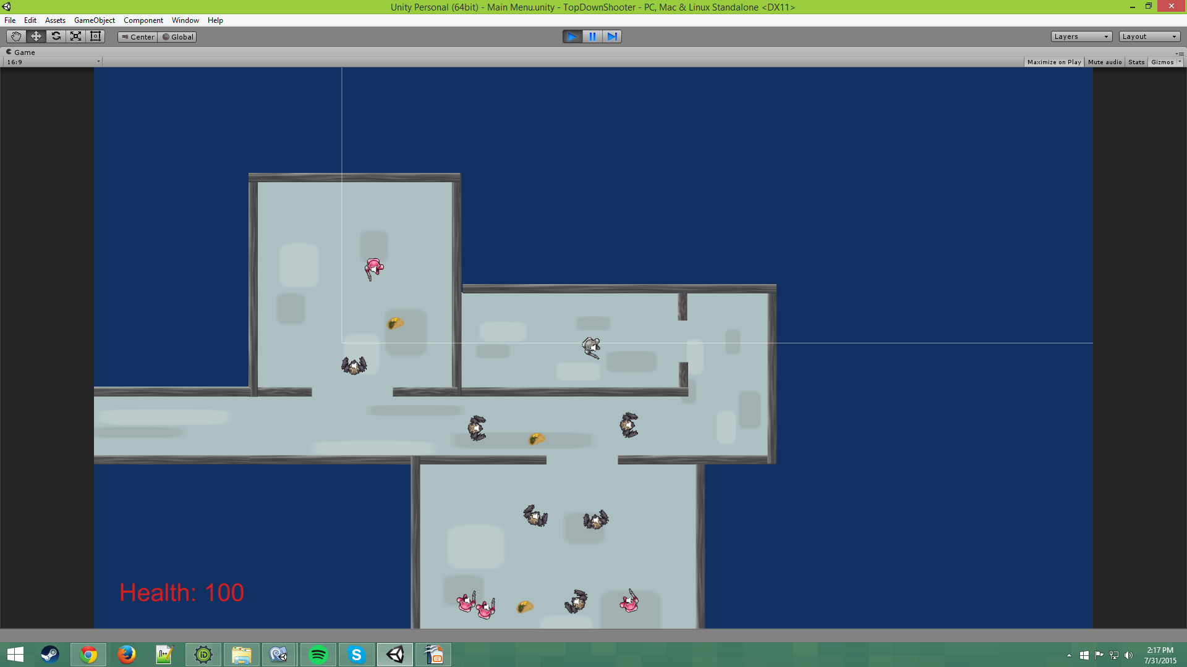
Future Milestones
• In the future I would like to finish a complete game
• I feel like I have learned a lot and could use this to push myself forward
Replace this image with your own screenshot. Then delete this text.

Slide 12
The End
Thank You for Watching!

